Slide 1
District 6 Community Meeting
April 15, 2021
Welcome Opening Remarks 6:30
LOGT Presentation 6:35
Jacksonville Sheriffs Office 7:10
Public Works Department 7:20
FL. Dept. of Transportation 7:30
Parks & Recreation 7:40
Waste Hauling Services 7:45
Concluding Remarks 7:55

Slide 2
Mayor’s Administration & JTA
Jordan Elsbury
Nat Ford, CEO - JTA
  LOGT Presentation

Slide 3
Jacksonville Sheriffs Office
Lt. Romano and Lt. Hartley
  Speeding
  Traffic & Safety Issues
  Crime
  Homeless & Beggars

Slide 4
Public Works Department
Bill Joyce
  Cleaning of Curbs on Old St Augustine (between Loretto & Losco)
  Install a 4-Way Stop Sign at intersection of Mandarin Rd & Brady Rd or Speed Humps
  Plans to improve drainage at Scott Mill/Claire Lane/Old River Road
  Is Orange Picker/Brady connection going to be a Stop, 4-Way Stop or Turn-about?

Slide 5
Florida Dept. of Transportation
Sara Pleasants
Medians on San Jose Boulevard (maintenance and litter issues)
Update on Electronic Street Signs on San Jose Blvd?
The traffic backs up on San Jose south starting at Sunbeam to 295. What is the possibility of adding a second lane dedicated to getting traffic on the Buckman bridge?

Slide 6
Parks & Recreation
Daryl Joseph
When do you start the work on Brady & Orange Pickers Dog Park Clearing?
When will the Annex building at the Senior Center reopen? And when will the Ceramics area be back up and running?
Concerns of the prospective development of Alberts Field
Expanding the Mandarin Park Marina to accommodate weekend boaters

Slide 7
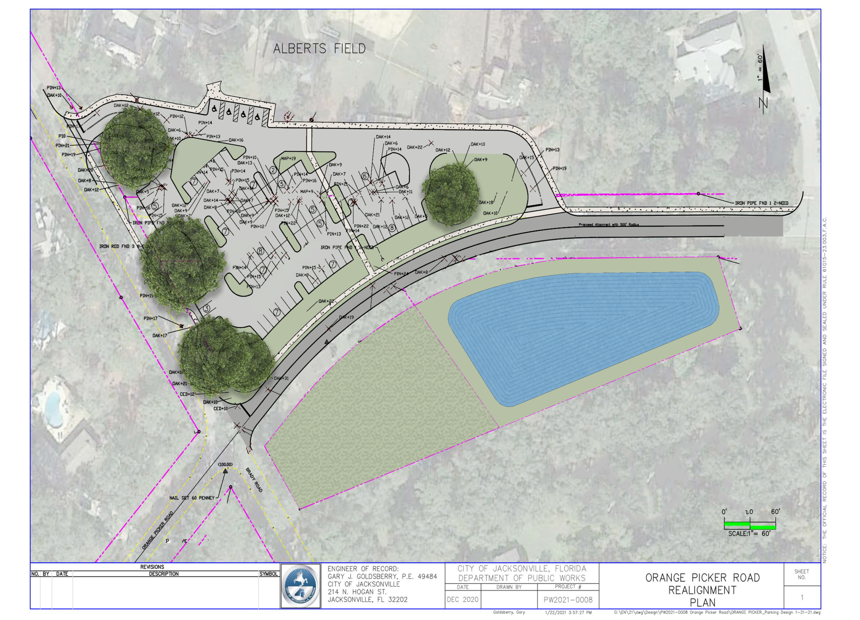

Slide 8
Waste Hauling Services
David Searcy, WastePro
On going challenges associated with meeting schedule; Continue to have scheduled day skipped for yard waste
Missed garbage pick-up an ongoing issue
Skip one side of a street

Slide 9
Miscellaneous & Closing Remarks
CM Boylan
1. Why is more high-traffic business being allowed to develop on San Jose (car wash, apartments, fast-food)?
2. Concern & objection to a new taxing district and want exclusion
3. Updates regarding the County Dock Rd. property Swap
4. Any prospects for use of the Kmart, Encore Décor, and Winn Dixie properties.

Slide 10
District 6 Community Meeting
**SAVE THE DATE**
July 22, 2021 Next Town Hall
Thank You
&
Stay Safe

